Slide 1
GOVERNMENT ARTS COLLEGE FOR WOMEN, SALEM-08 (AFFILIATED TO PERIYAR UNIVERSITY,SALEM-11)
DEPARTMENT OF COMPUTER SCIENCE
MINI PROJECT
S.S.SUDARSINI
(Reg No.C21UG104CSC066)
&
V.R.SUWEETTHA
(Reg No.C21UG104CSC070)
Internal Guide: Head Of The Department
Mrs.P.Kanangavalli, Dr.N.Hemageetha,
M.Sc.,M.Phil.,B.Ed., M.C.A.,M.Phil.,Ph.D.,

Slide 2
E-COMMERCE WEBSITE FOR SALESING LAPTOP SAPRES AND ACCESSORIES
USING PHP & MYSQL

Slide 3
INTRODUCTION
This project e-commerce is website project is mainly developed in HTML, CSS, BOOTSTRAP.
This software helps to buy laptop components and spare part in our website. This system will save time and increase work efficiency related to manage the computer stock and transactions of the business.
The e-commerce website project focused on selling laptop spare parts, emphasizing customization options for users.
It outlines the objectives, features, target audience, and technical specifications tailored specifically for this niche. Ensure a seamless shopping experience for users, regardless of their technical expertise.

Slide 4
ABSTRACT
Creative Laptop Parts & Accessories is an innovative ecommerce platform dedicated to providing customers with a comprehensive selection of high-quality spare parts and accessories for laptops.
With a commitment to excellence and customer satisfaction, our platform aims to simplify the process of finding and purchasing essential components for laptop repair, upgrade, and customization.
Individual consumers looking to repair or upgrade their laptops.

Slide 5
SYSTEM ANALYSIS
The existing system for purchasing laptop spare parts and accessories typically involves customers visiting physical stores or online marketplaces with varying product availability and reliability.
Customers may encounter challenges such as limited product options, difficulty in finding specific items, inconsistent product quality, and lack of personalized customer support.
Online marketplaces may lack dedicated customer service channels, leading to frustration and dissatisfaction among customers.

Slide 6
SYSTEM REQUIREMENT SPECIFICATION
HARDWARE SPECIFICATIONS PROCESS :
PENTIUM-IV RAM : 2GB
HARD DISK : 750 GB
SOFTWARE SPECIFICATIONS:
OPERATING SYSTEM : WINDOWS 2000/XP/7/8/8.1
SERVER : WAMP SERVER
FRONT END : PHP
BACK END : MYSQL

Slide 7
FRONT END
HTML
CSS
BOOTSTRAP
CONNECTER : PHP
BACK END
MY SQL

Slide 8
USER MODULE
Home
Laptop spare
Accessories
Contacts Us
Customize Order

Slide 9
ADMIN MODULE
Home
Add Product
Add Accessories
All Product
All Accessories
Customize Orders
Orders

Slide 10
SYSTEM TESTING
Software testing is an important element of software quality assurance and represents the ultimate review of specification, design and coding. In testing, the engineer creates a series of test cases that are intended to demolish the software that has been built.
NEED FOR TESTING :
¬ To click the efficiency of the system.
¬ To remove the errors of the system.
¬ To check whether the objectives of the project are accomplished.
¬ To enable the removal of complexities.
¬To check the flexibility of the system.

Slide 11
FUNCTIONAL TESTING :
Functional tests provide systematic demonstrations that functions tested are available as specified by the business and technical requirements, system documentation, and user manuals. Functional testing is centered on the following items:
Valid Input → identified classes of valid input must be accepted. Invalid Input - identified classes of invalid input must be rejected.
Functions → identified functions must be exercised. Output - identified classes of application outputs must be Exercised.
Procedures → interfacing systems or procedures must be invoked.

Slide 12
DATA FLOW DIAGRAM(DFD)
A flowchart is a graphical representation of a process, system, or algorithm, typically using standardized symbols and arrows to depict the sequence of steps and decision points.
Source of Data →
Data Flow →
Process →
Storage →

Slide 13
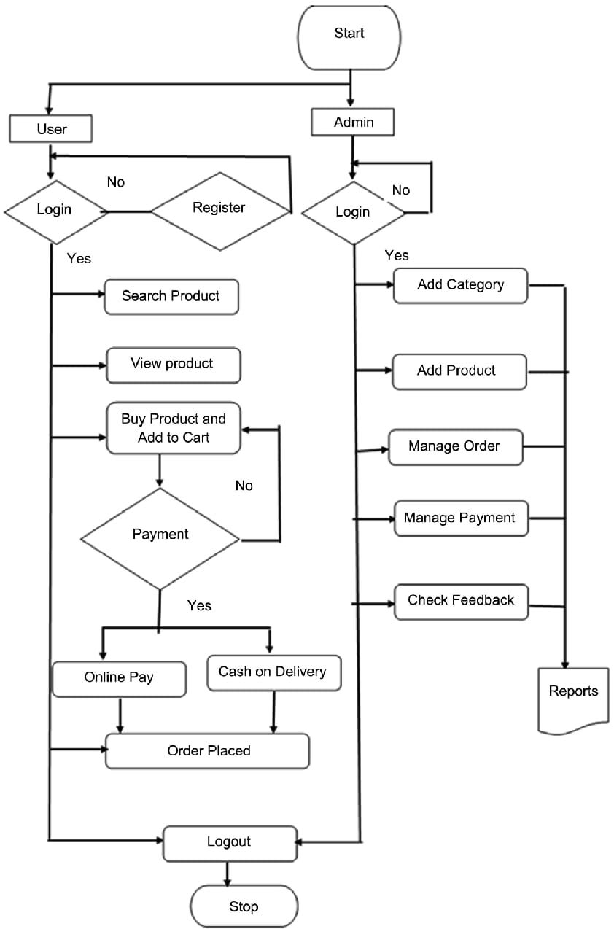
FLOW DIAGRAM :

Slide 14
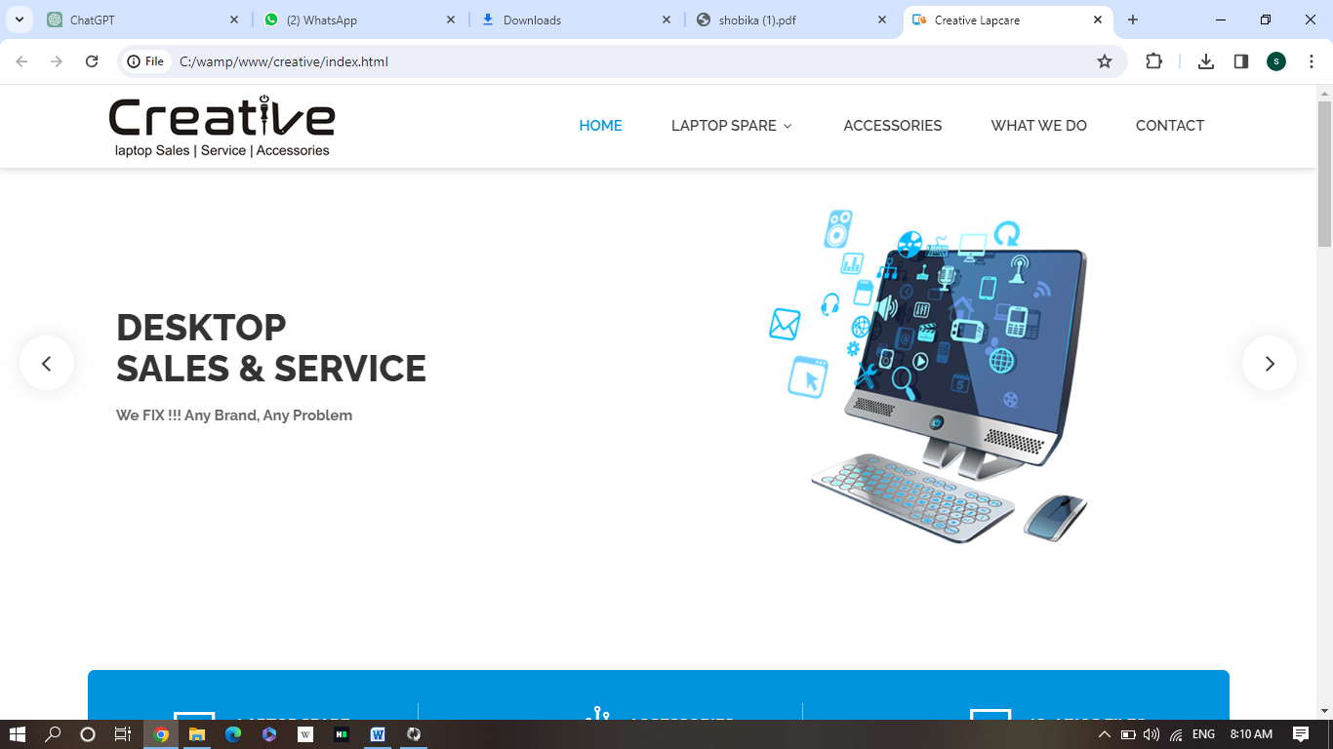
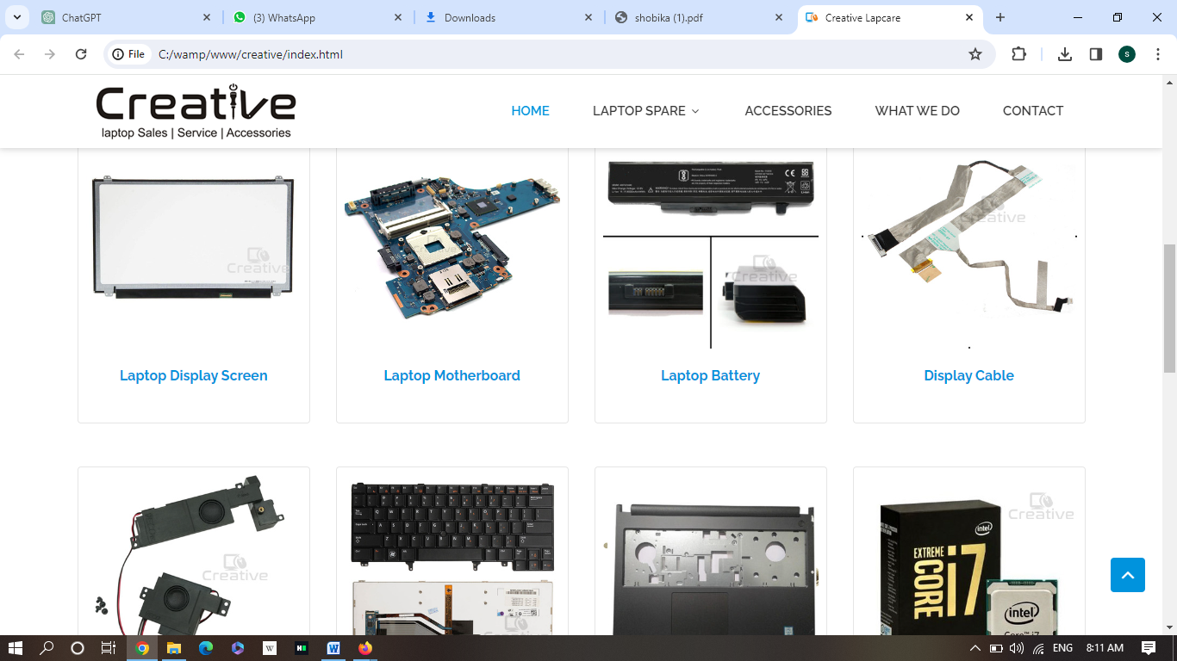
HOME PAGE

Slide 15
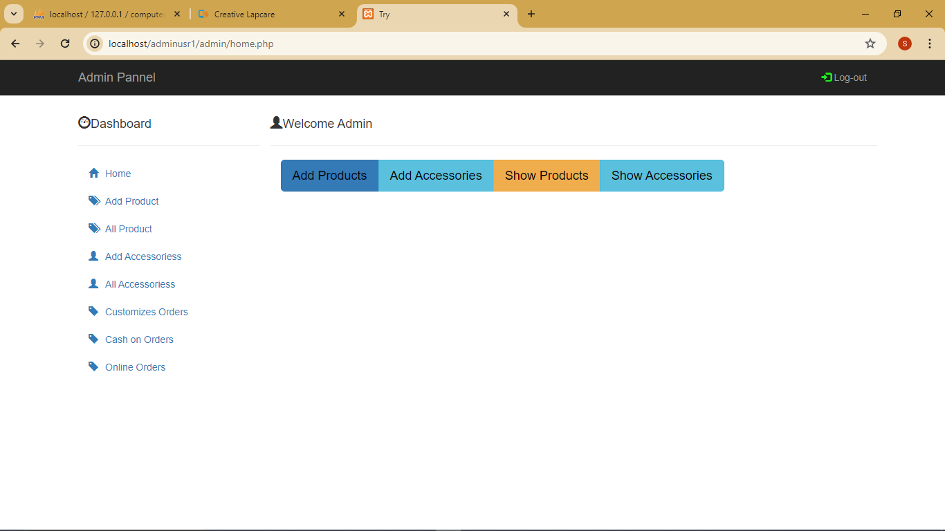
Admin Page:

Slide 16
CONCLUSION
Reduced errors due to human intervention.
Easy to retrieval of information.
User friendly screens to enter the data.
Fast finding of information requested.

Slide 17
REFERENCE
For PHP :
https://www.w3schools.com/php
https://www.php.net/
For MySQL :
https://www.mysql.com/
https://www.mysqltutorial.org
For Wamp Server :
https://www.apachefriends.org/download.html

Slide 18
THANK YOU

